Slide 1
Claire Corey
To start my investigation, I researched the differences in girl’s lives in various places around the world. I wondered how certain facial expressions portray personality traits? What shows potential in young girls in their different living conditions? I chose this investigation because I have lived in Utah most of my life and I wanted to explore how young girls impact places I have never seen before.
I initially tried painting pictures with girls who only have serious facial expressions. I ended up changing my mind. The girl I painted with the turquoise head scarf has a serious expression and this shows her personality. However, with the Indian girl with her hand over her face, I felt a mischievous look better satisfied her personality. I tried to push the idea of facial expressions portraying a part of a person. For example, the Indian girl with the light blue background looks carefree; while the African baby looks more curious. I had to completely revise my painting with the purple background. I messed up her facial proportions. I had to learn how to identify the planes of her face in order to fix the painting. These paintings had me question: what are their roles in society?
My Sustained Investigation

Slide 2
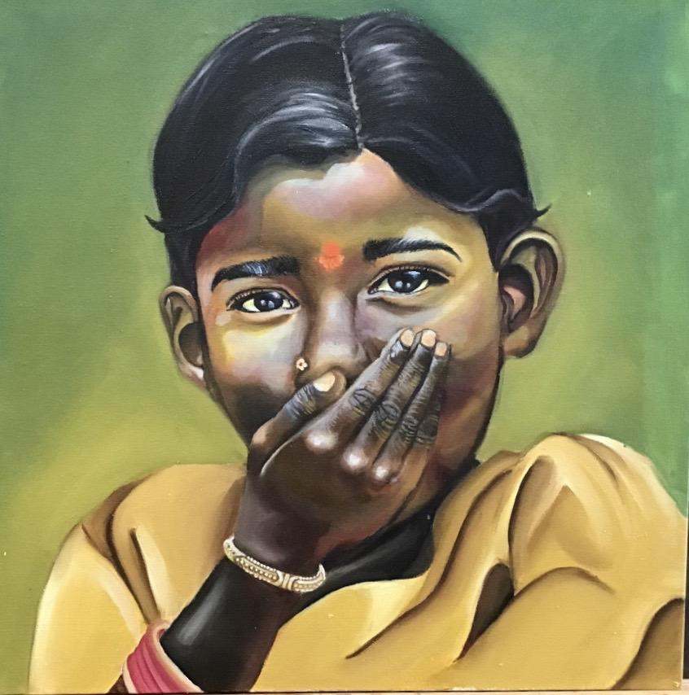
Delhi, India
Oil on Canvas
17” by 17” NFS
I wanted this painting to represent humor that can be found in different situations. I tried to make this young girl look mischievous in a unique place.

Slide 3
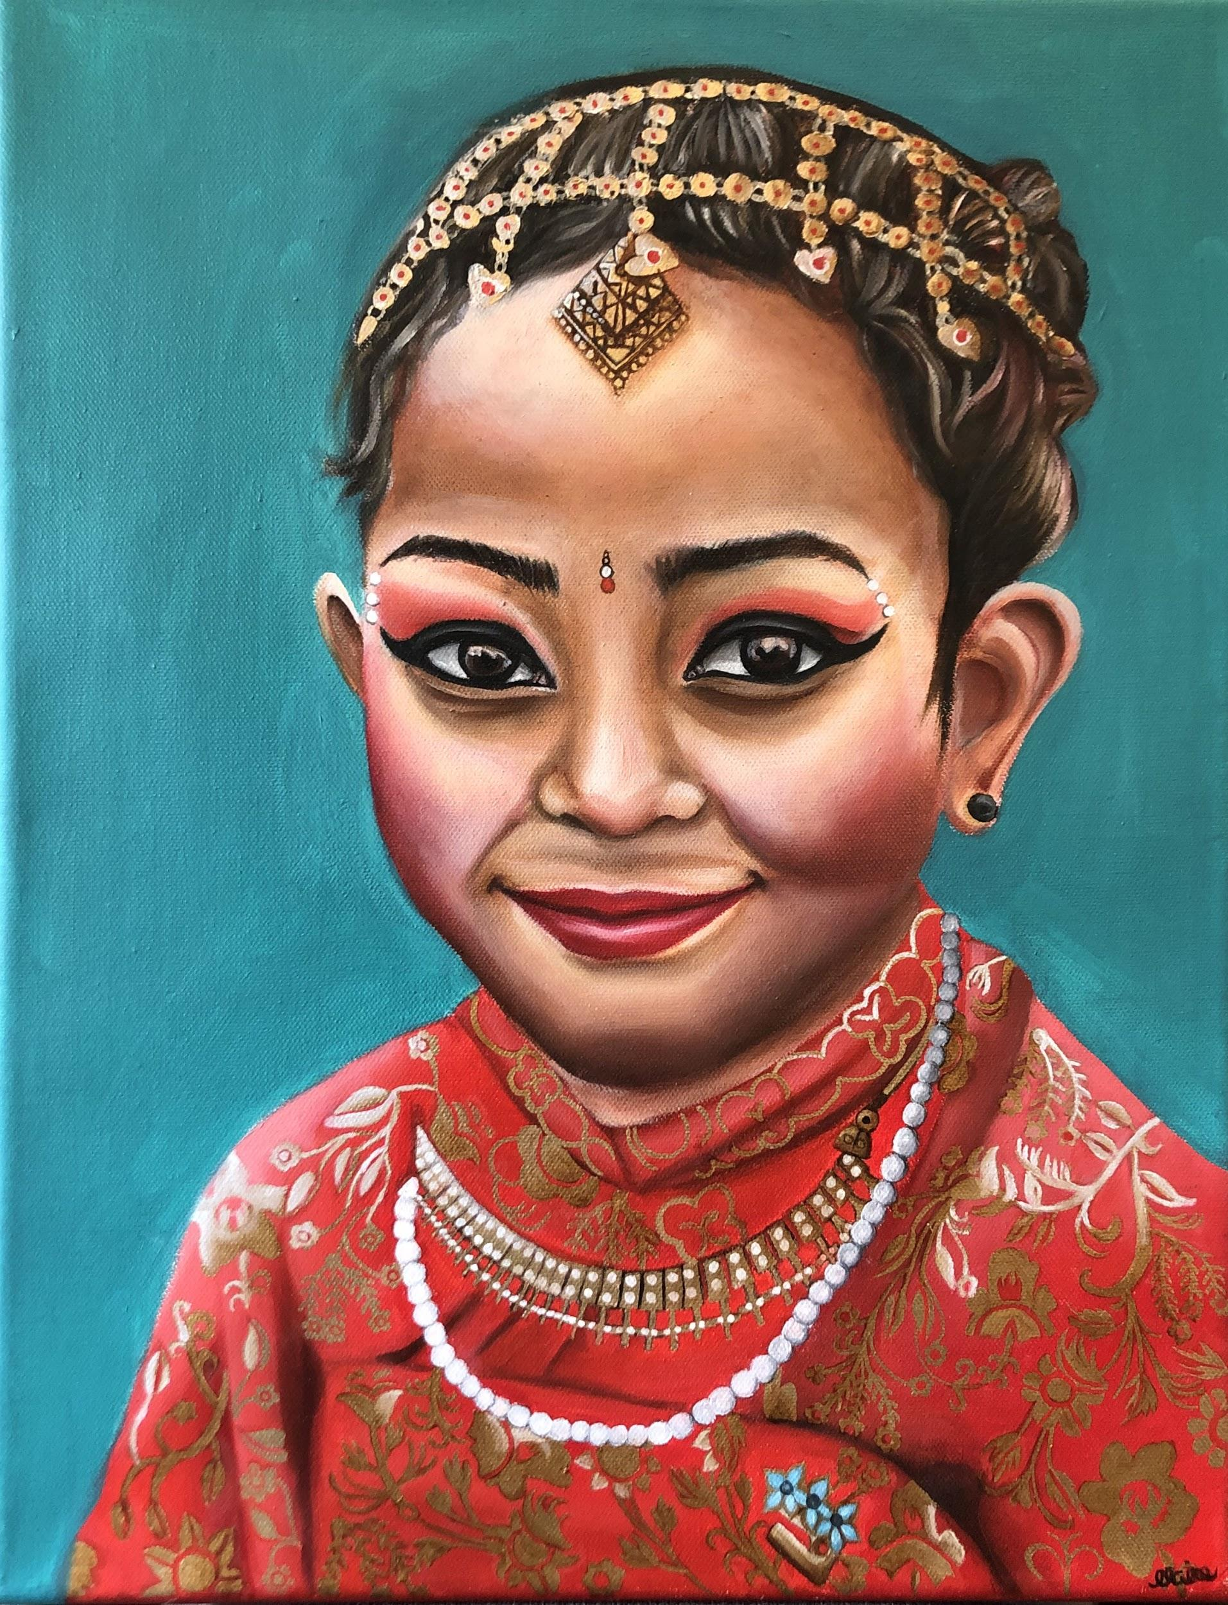
Nepal
Oil on Canvas
16” by 13” NFS
This painting represents how traditional clothing can still show uniqueness in an individual. This girl is wearing traditional Nepali clothing, but you can still see personality showing through with her expression.

Slide 4
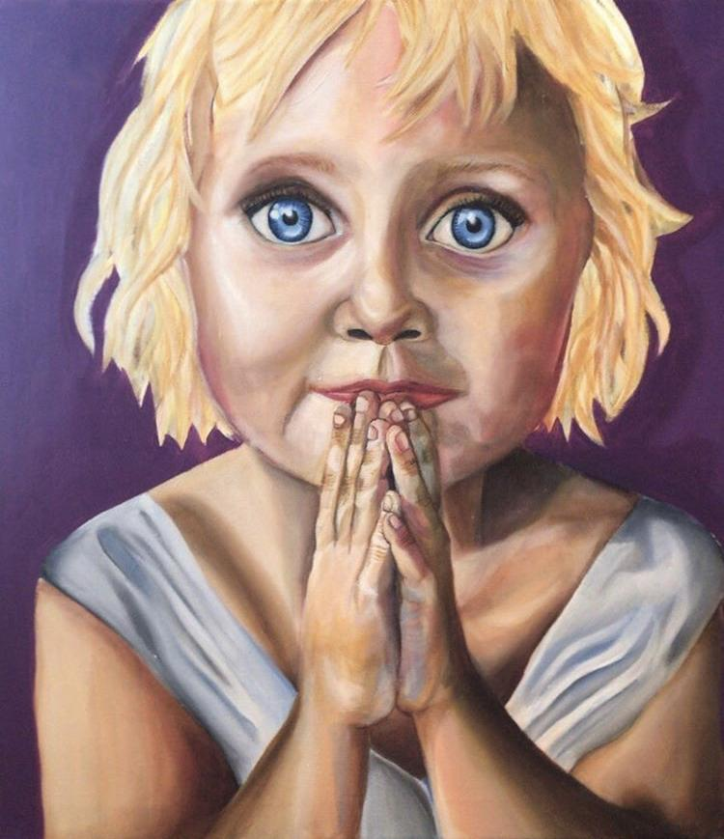
Norway
Oil on Canvas
24” by 24” $300.00
This painting represents innocence. It shows the unique perspective a child can have.

Slide 5
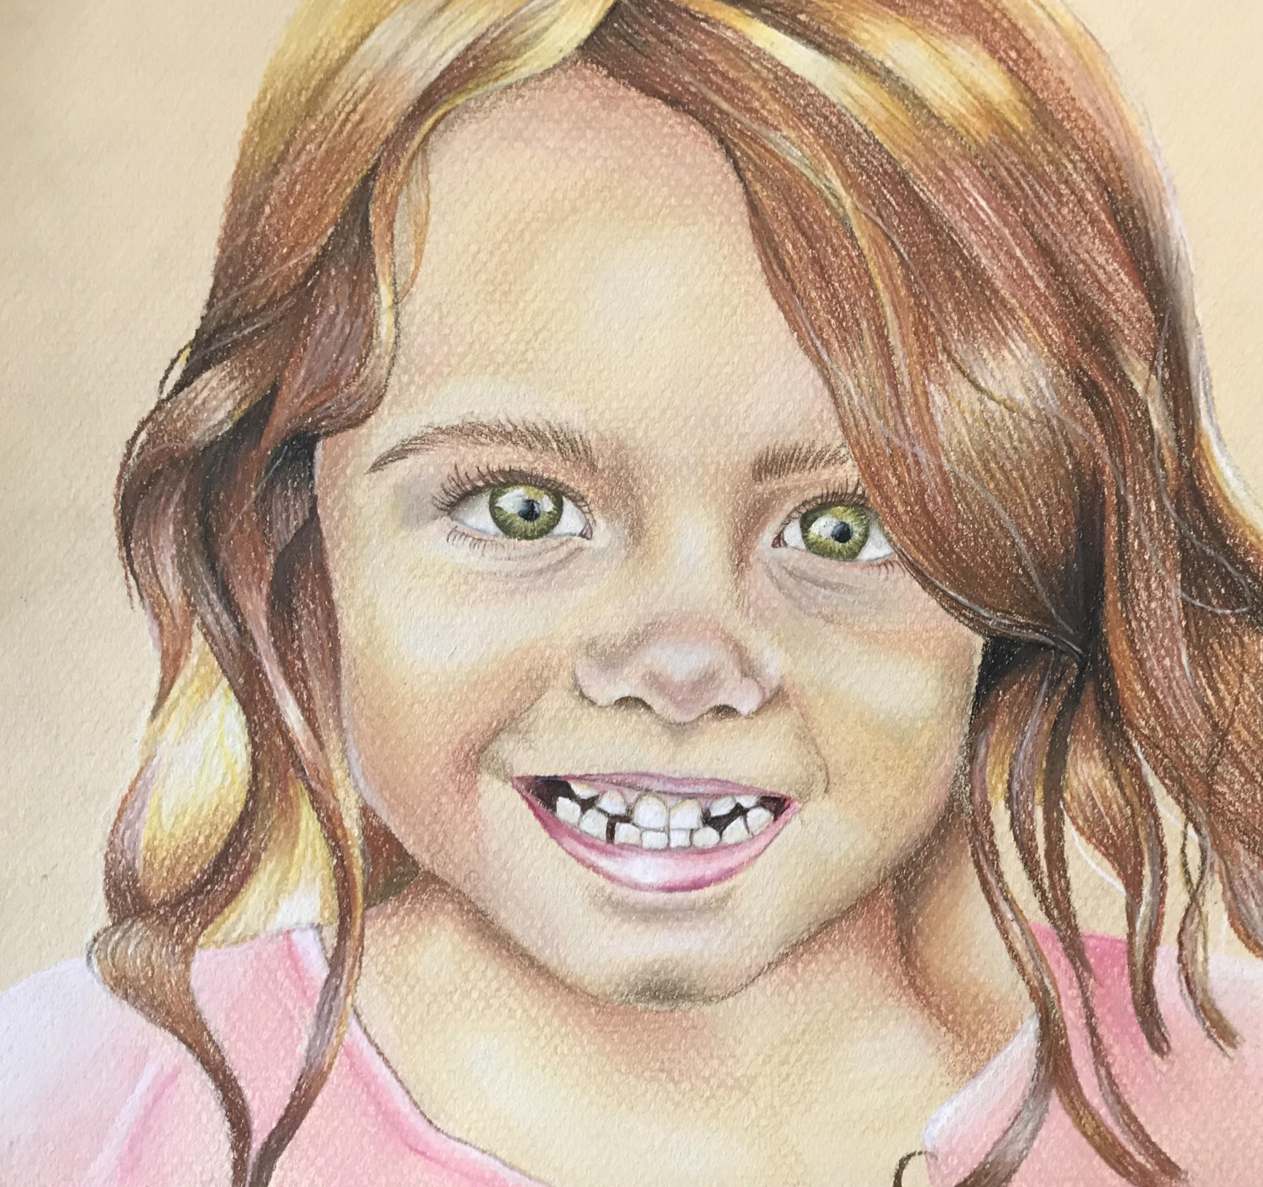
England
Prismacolor
8½” by 8” NFS
This painting has a focal point on the eyes. I did this in order to show that eyes alone can be a good representation of a person’s personality.

Slide 6
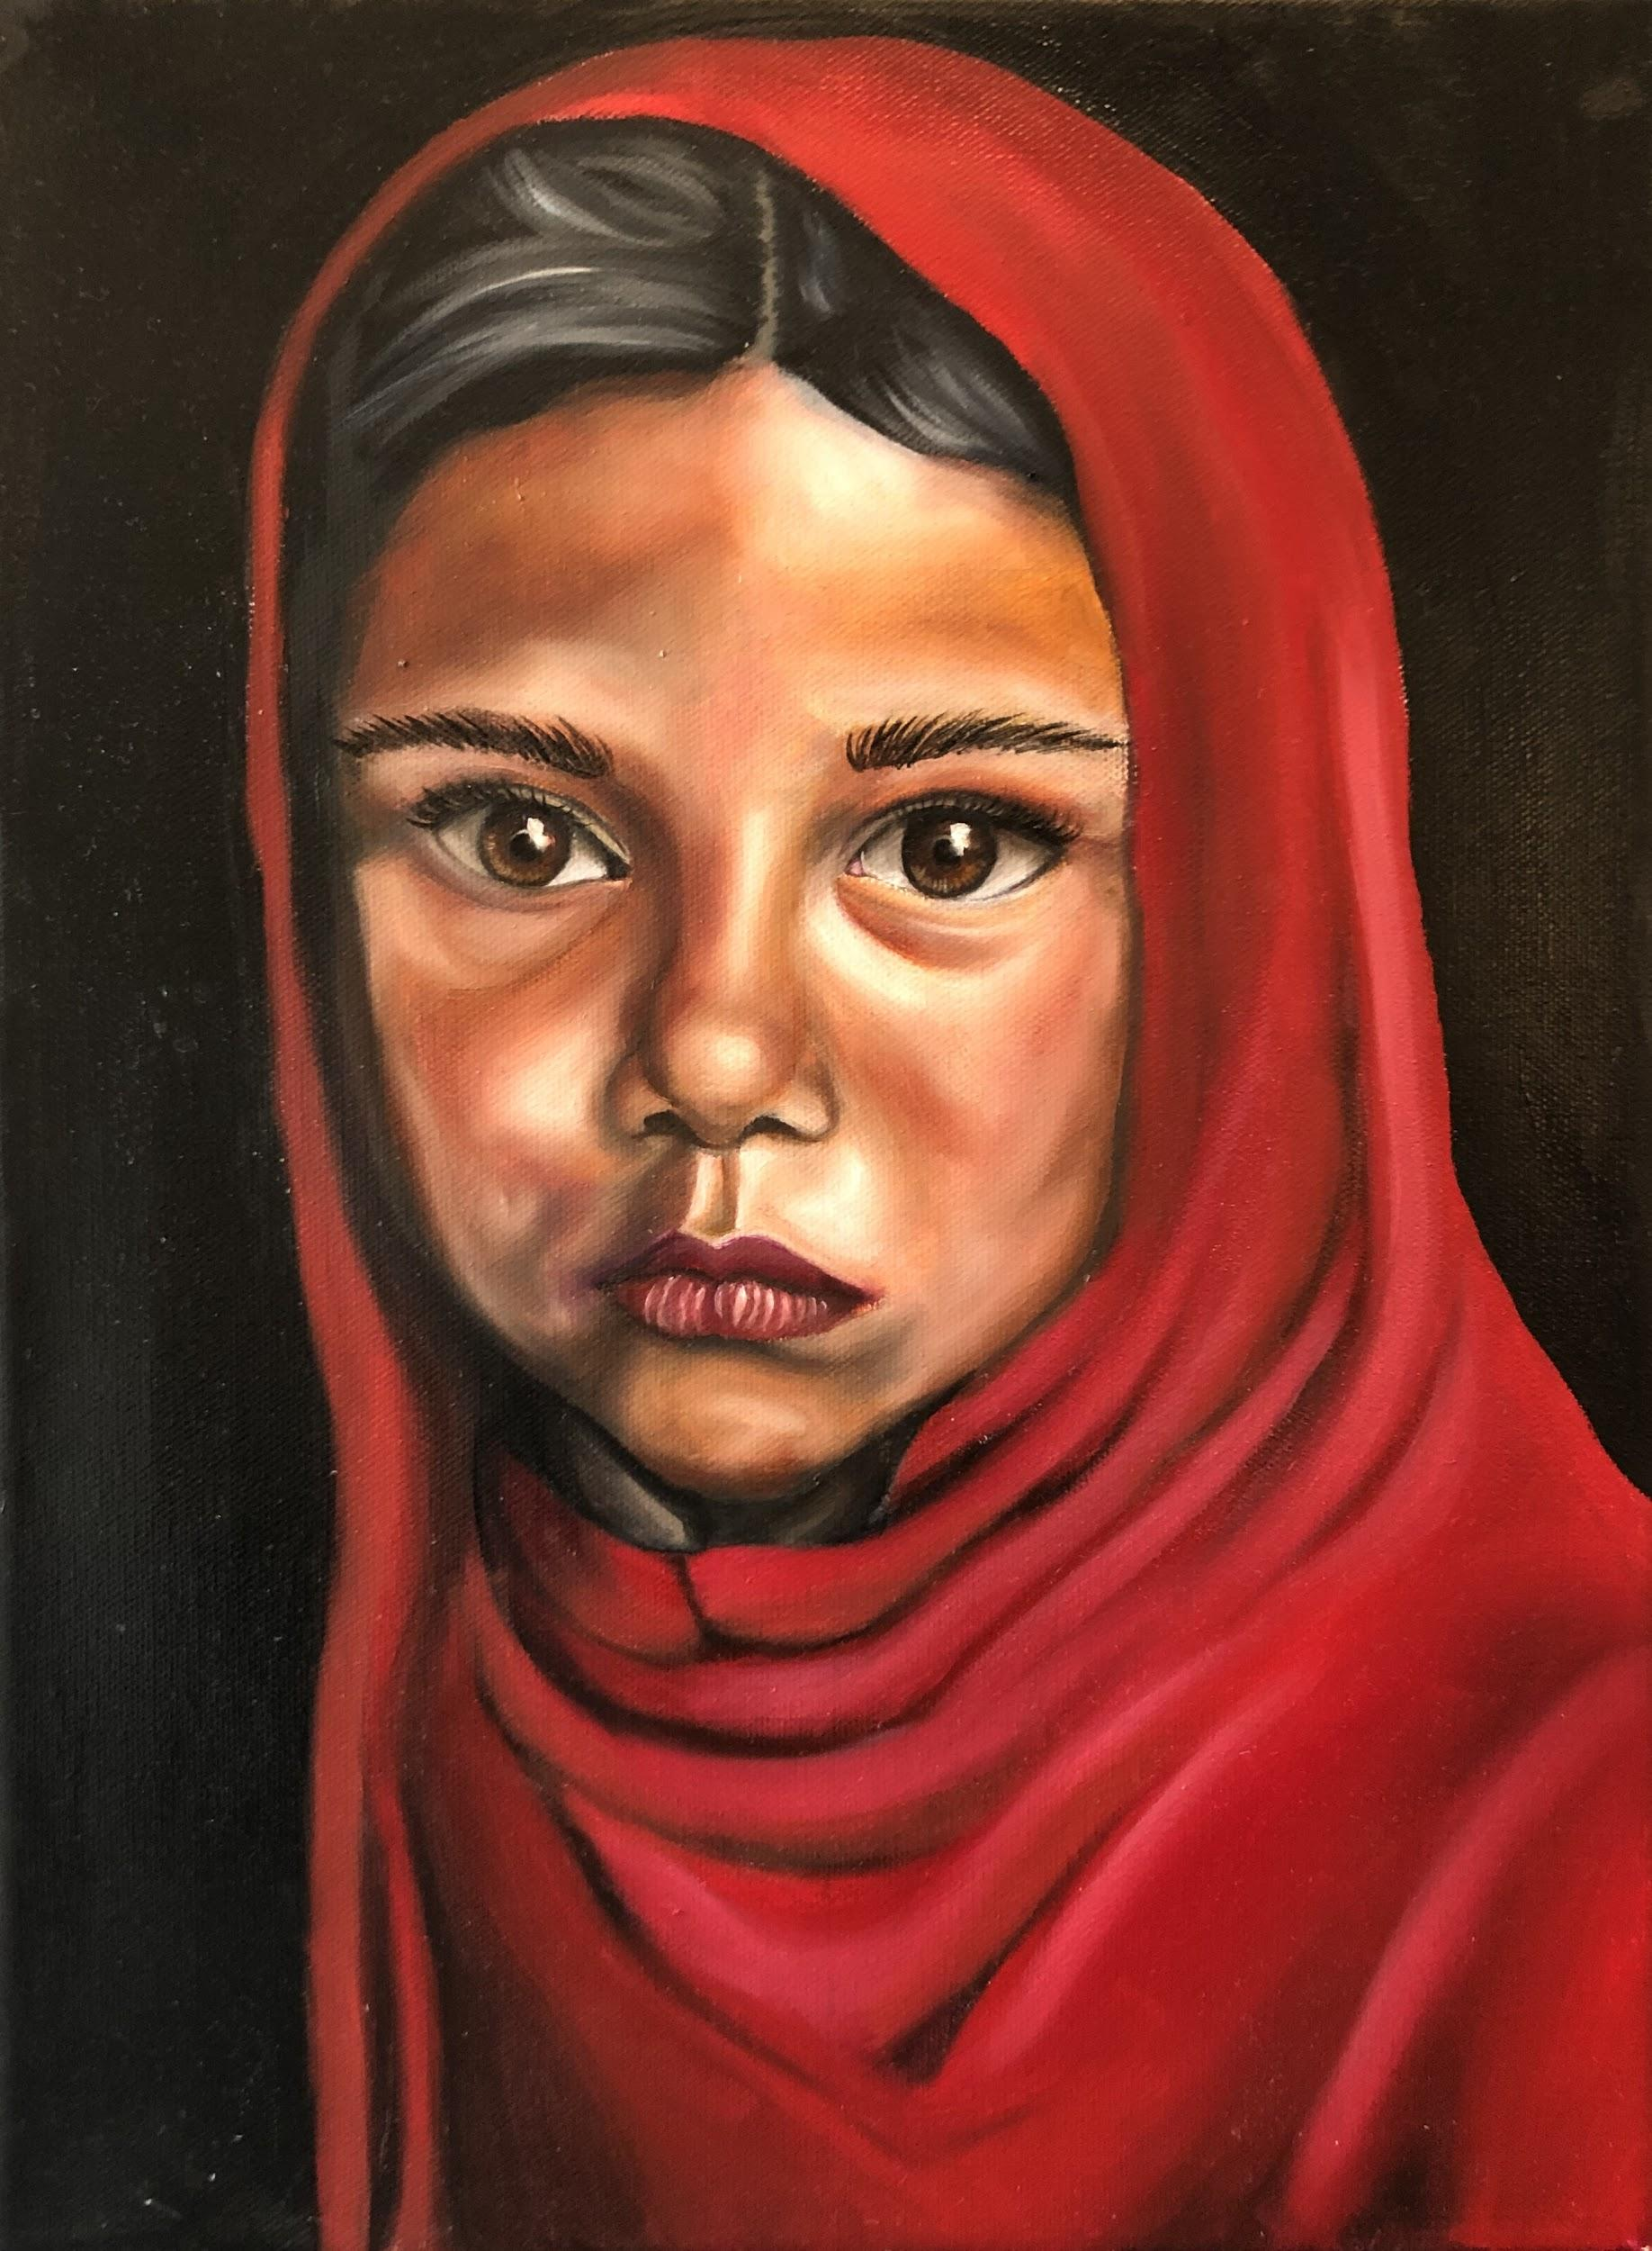
Bangladesh
Oil on Canvas
15” by 12” NFS
The contrast in this piece is a representation of the highs and lows of life. This young girl is going through a low in her life, but in the future there will be highs.

Slide 7
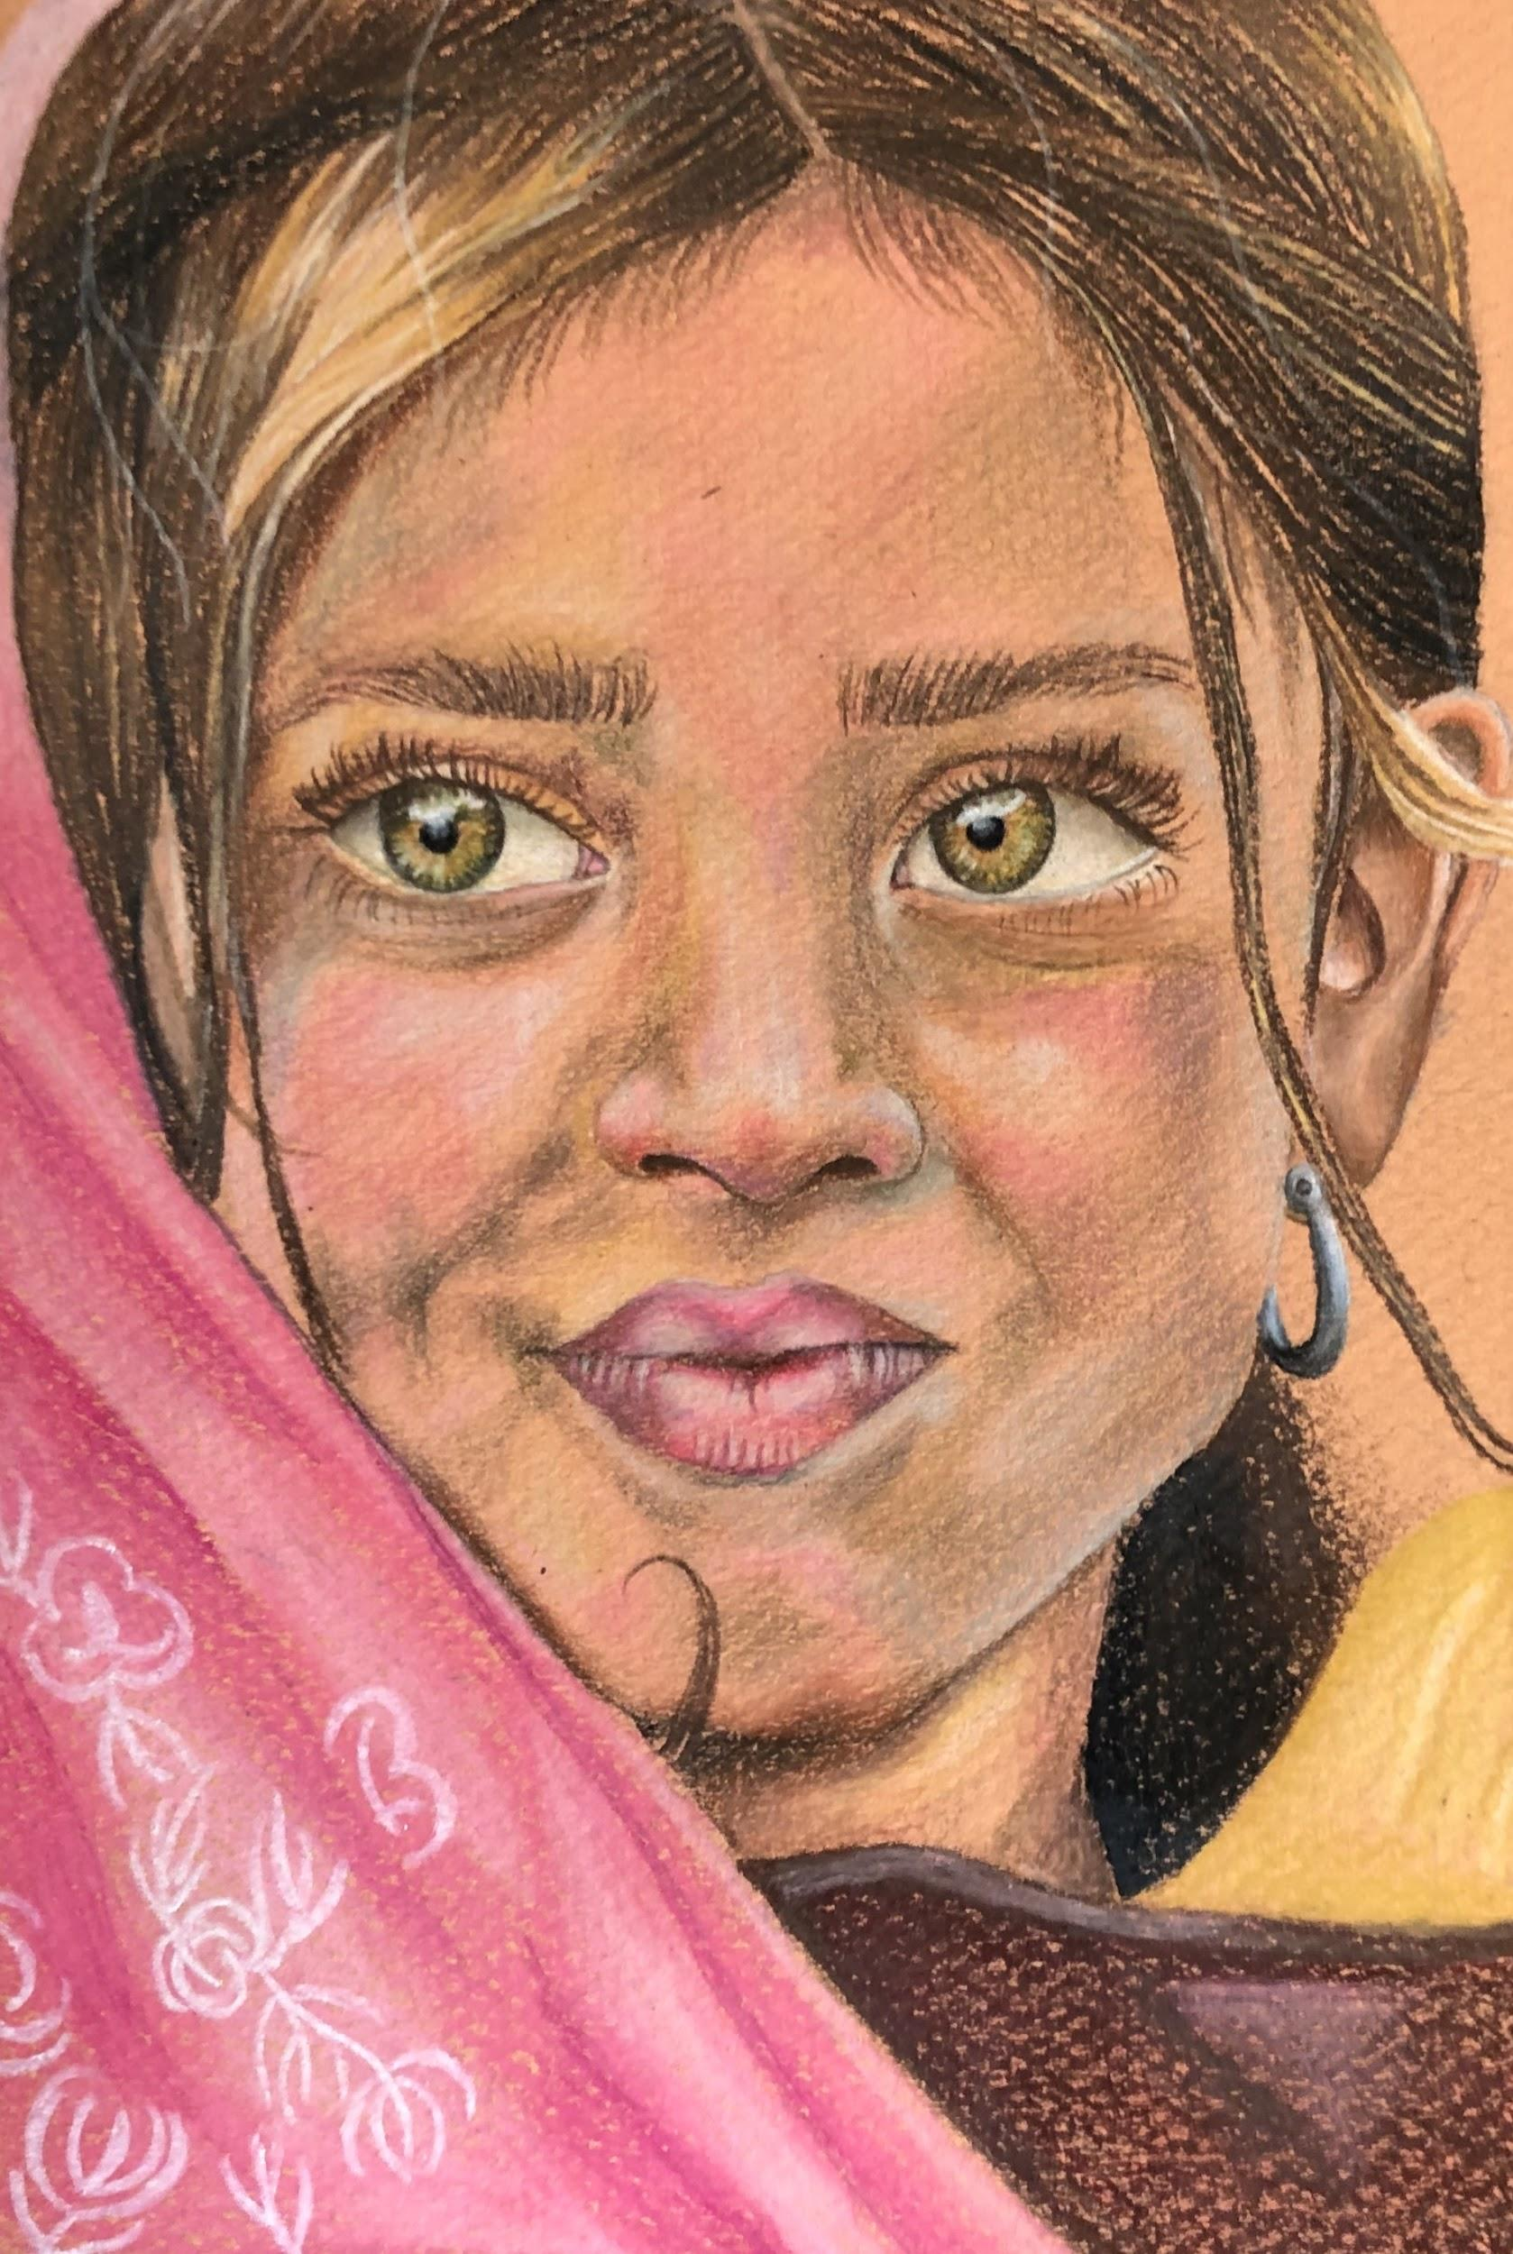
Pakistan
Prismacolor
8” by 5½” NFS
I used this girl’s expressive face to show the potential all young girls have.

Slide 8
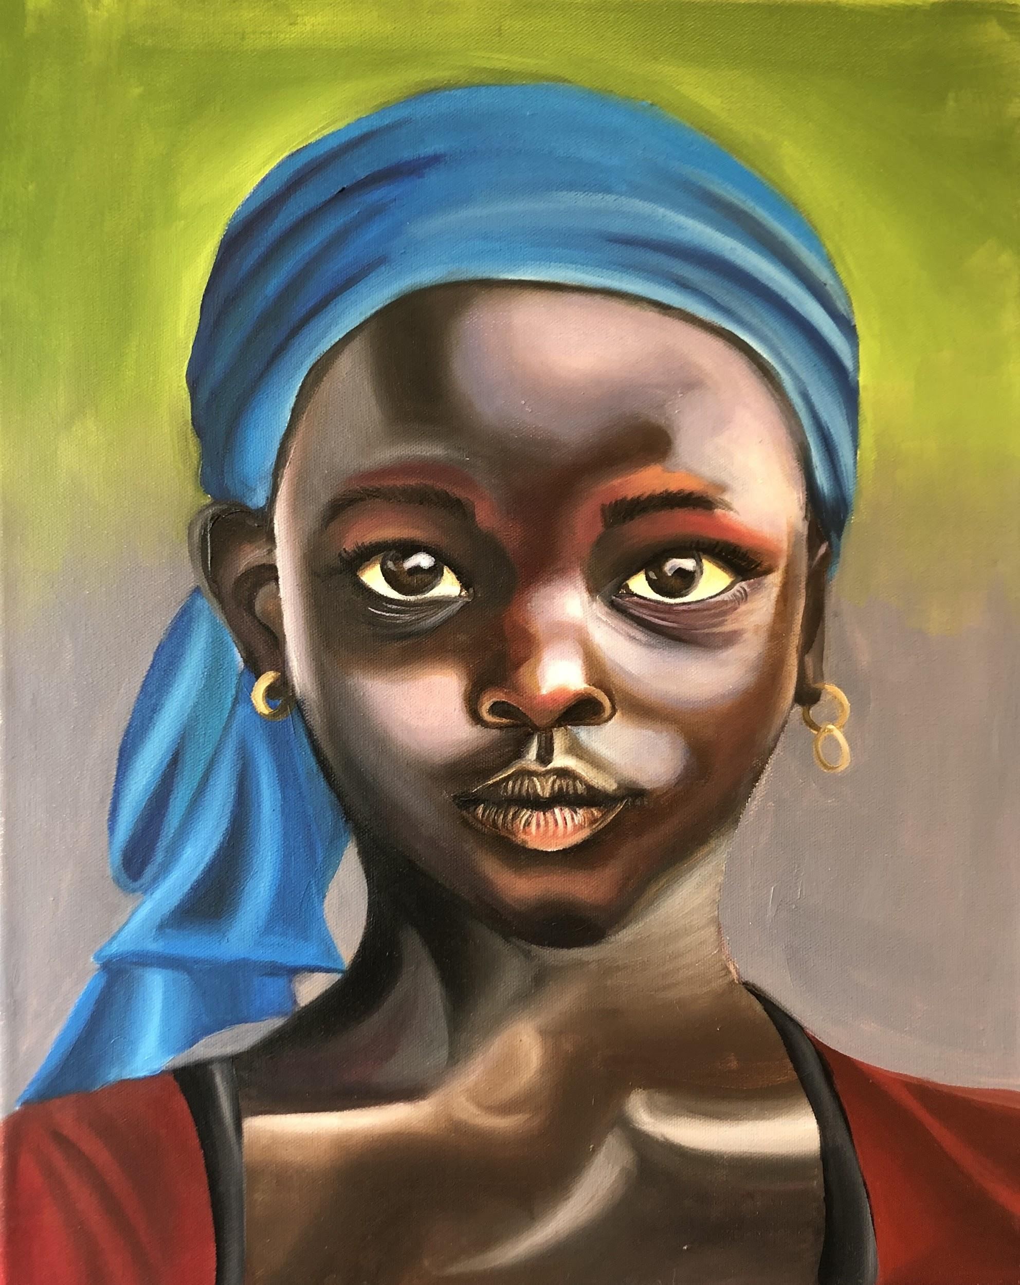
Ghana
Oil on Canvas
17” by 14” NFS
This painting represents determination. Her expression and stance shows a more focused part of her personality.

Slide 9
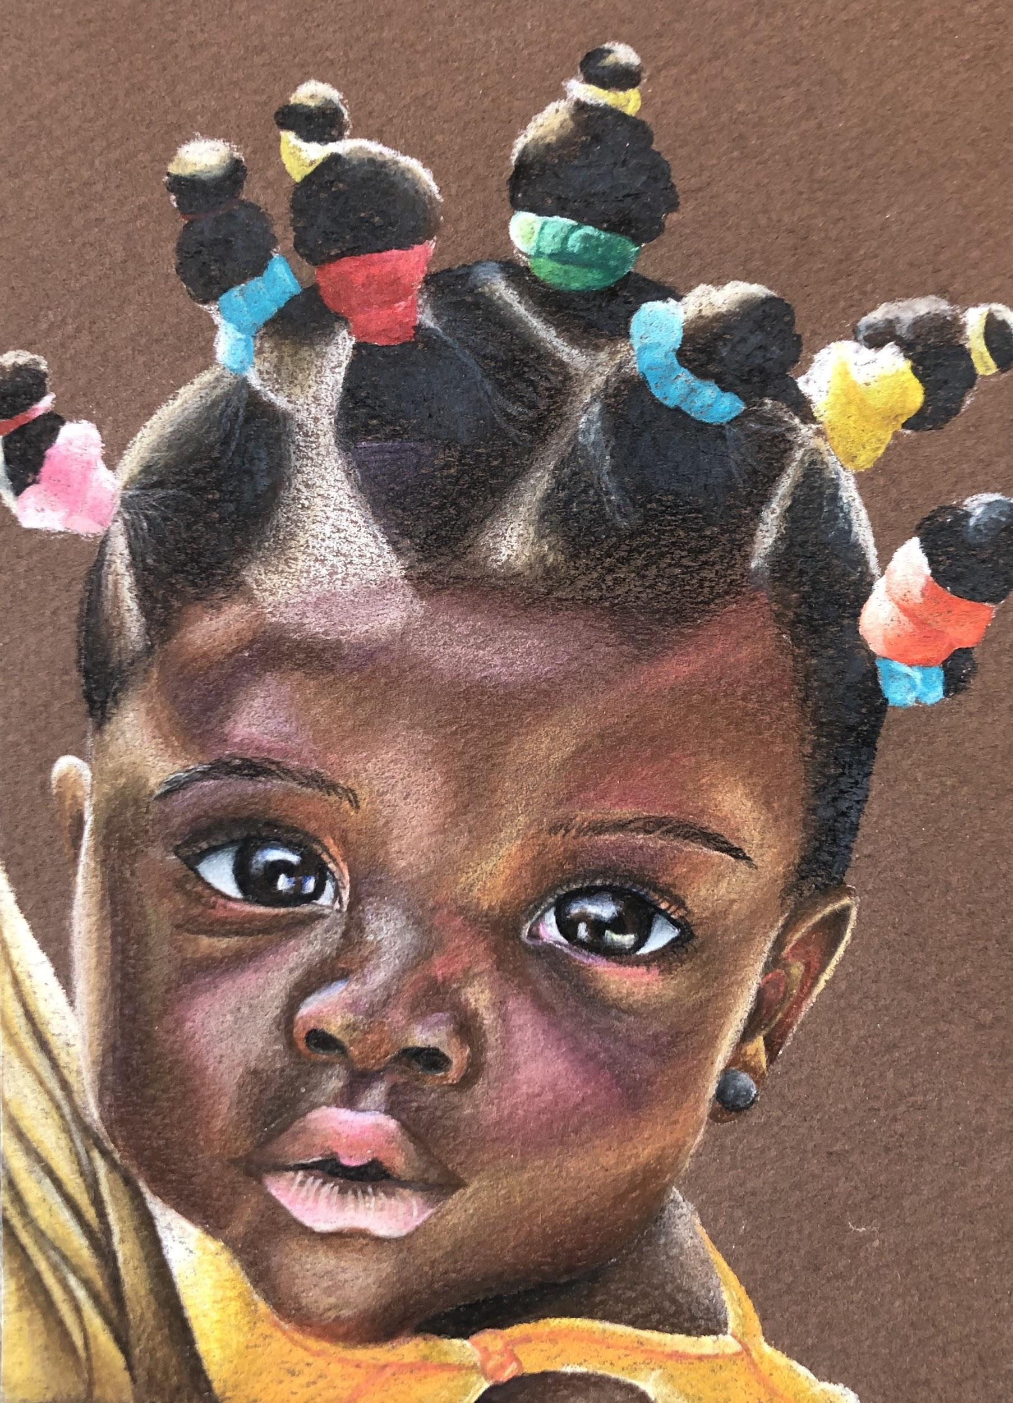
Libya
Prismacolor
7” by 5” NFS
This drawing represents the love of a mother. The baby’s hairstyle shows how much her Mother cares for her.

Slide 10
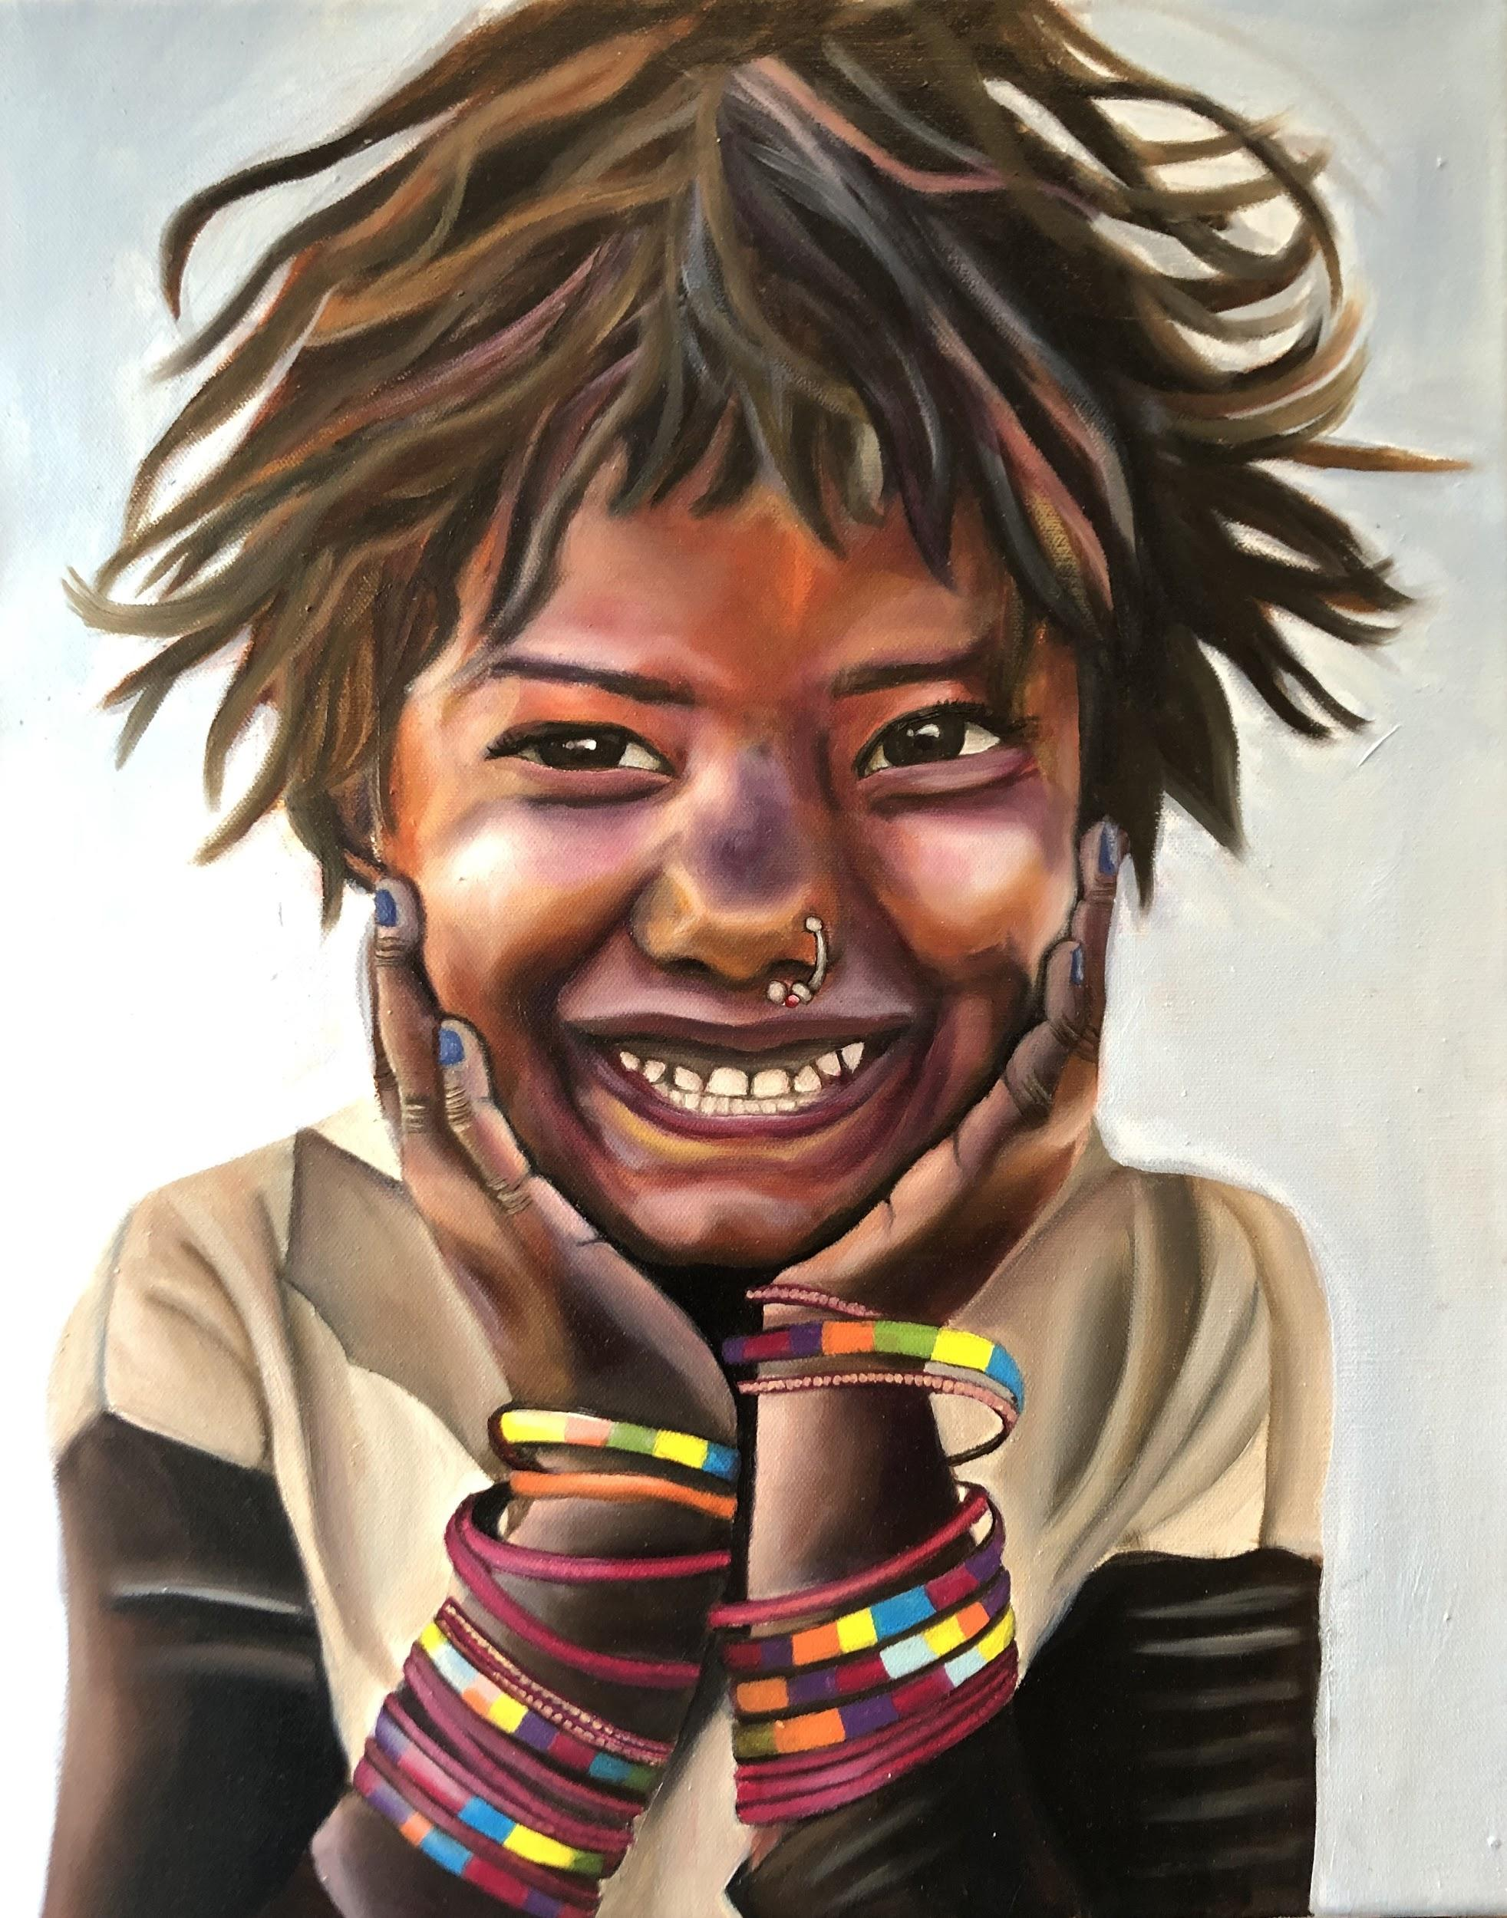
Kochi, India
Oil on Canvas
17” by 14” NFS
The bright colors in this painting represents happiness. I wanted the warm bright colors to radiate the happiness this girl is feeling.

Slide 11
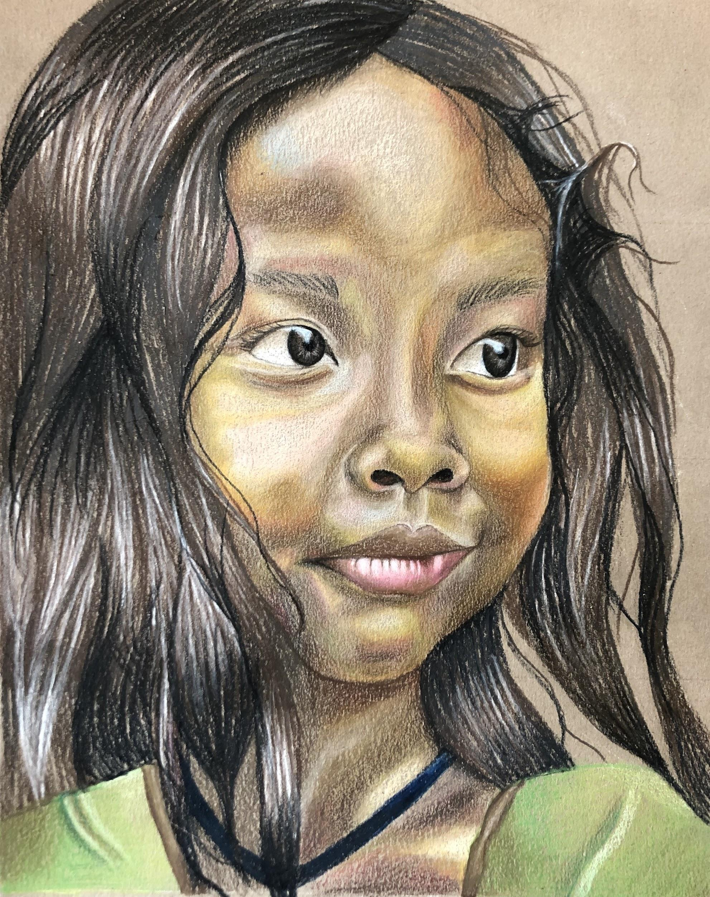
Phuket, Thailand
Prismacolor
9” by 7½” NFS
This painting represents the calmness in a single moment.

Slide 12
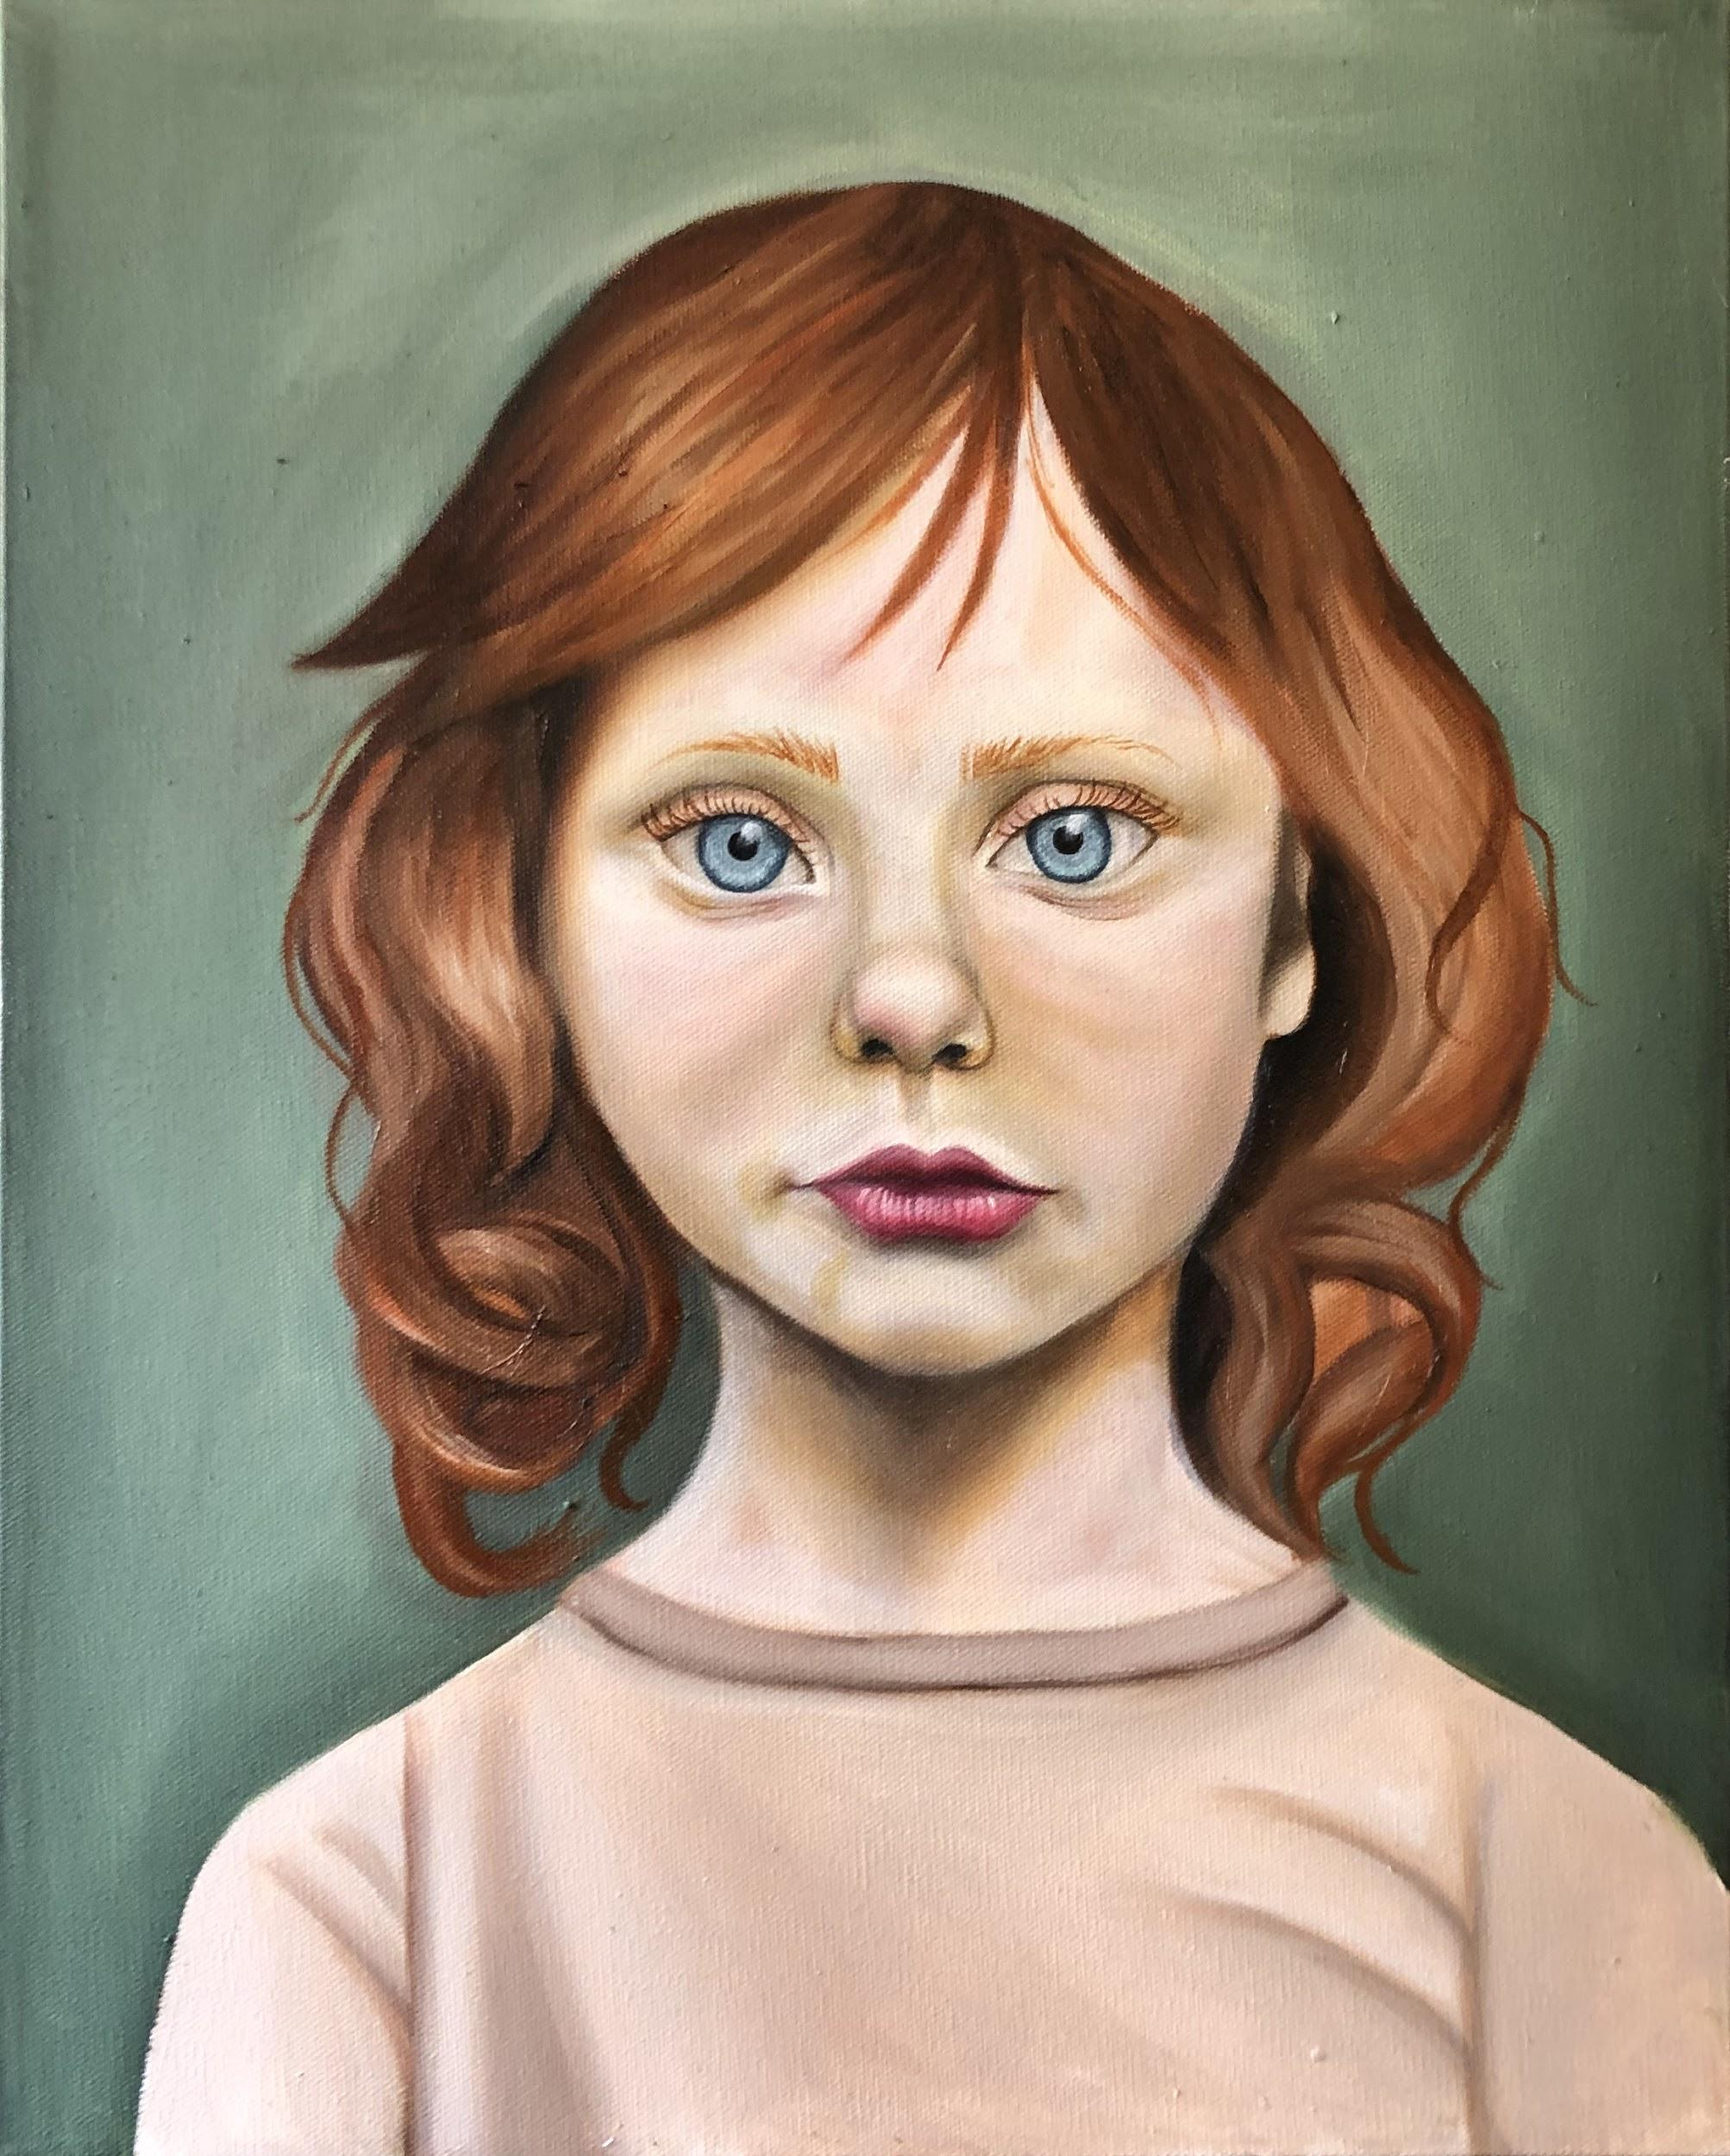
Scotland
Oil on Canvas
20” by 15” NFS
This painting represents discipline. This girl’s facial expressions show a maturity beyond her years.

Slide 13
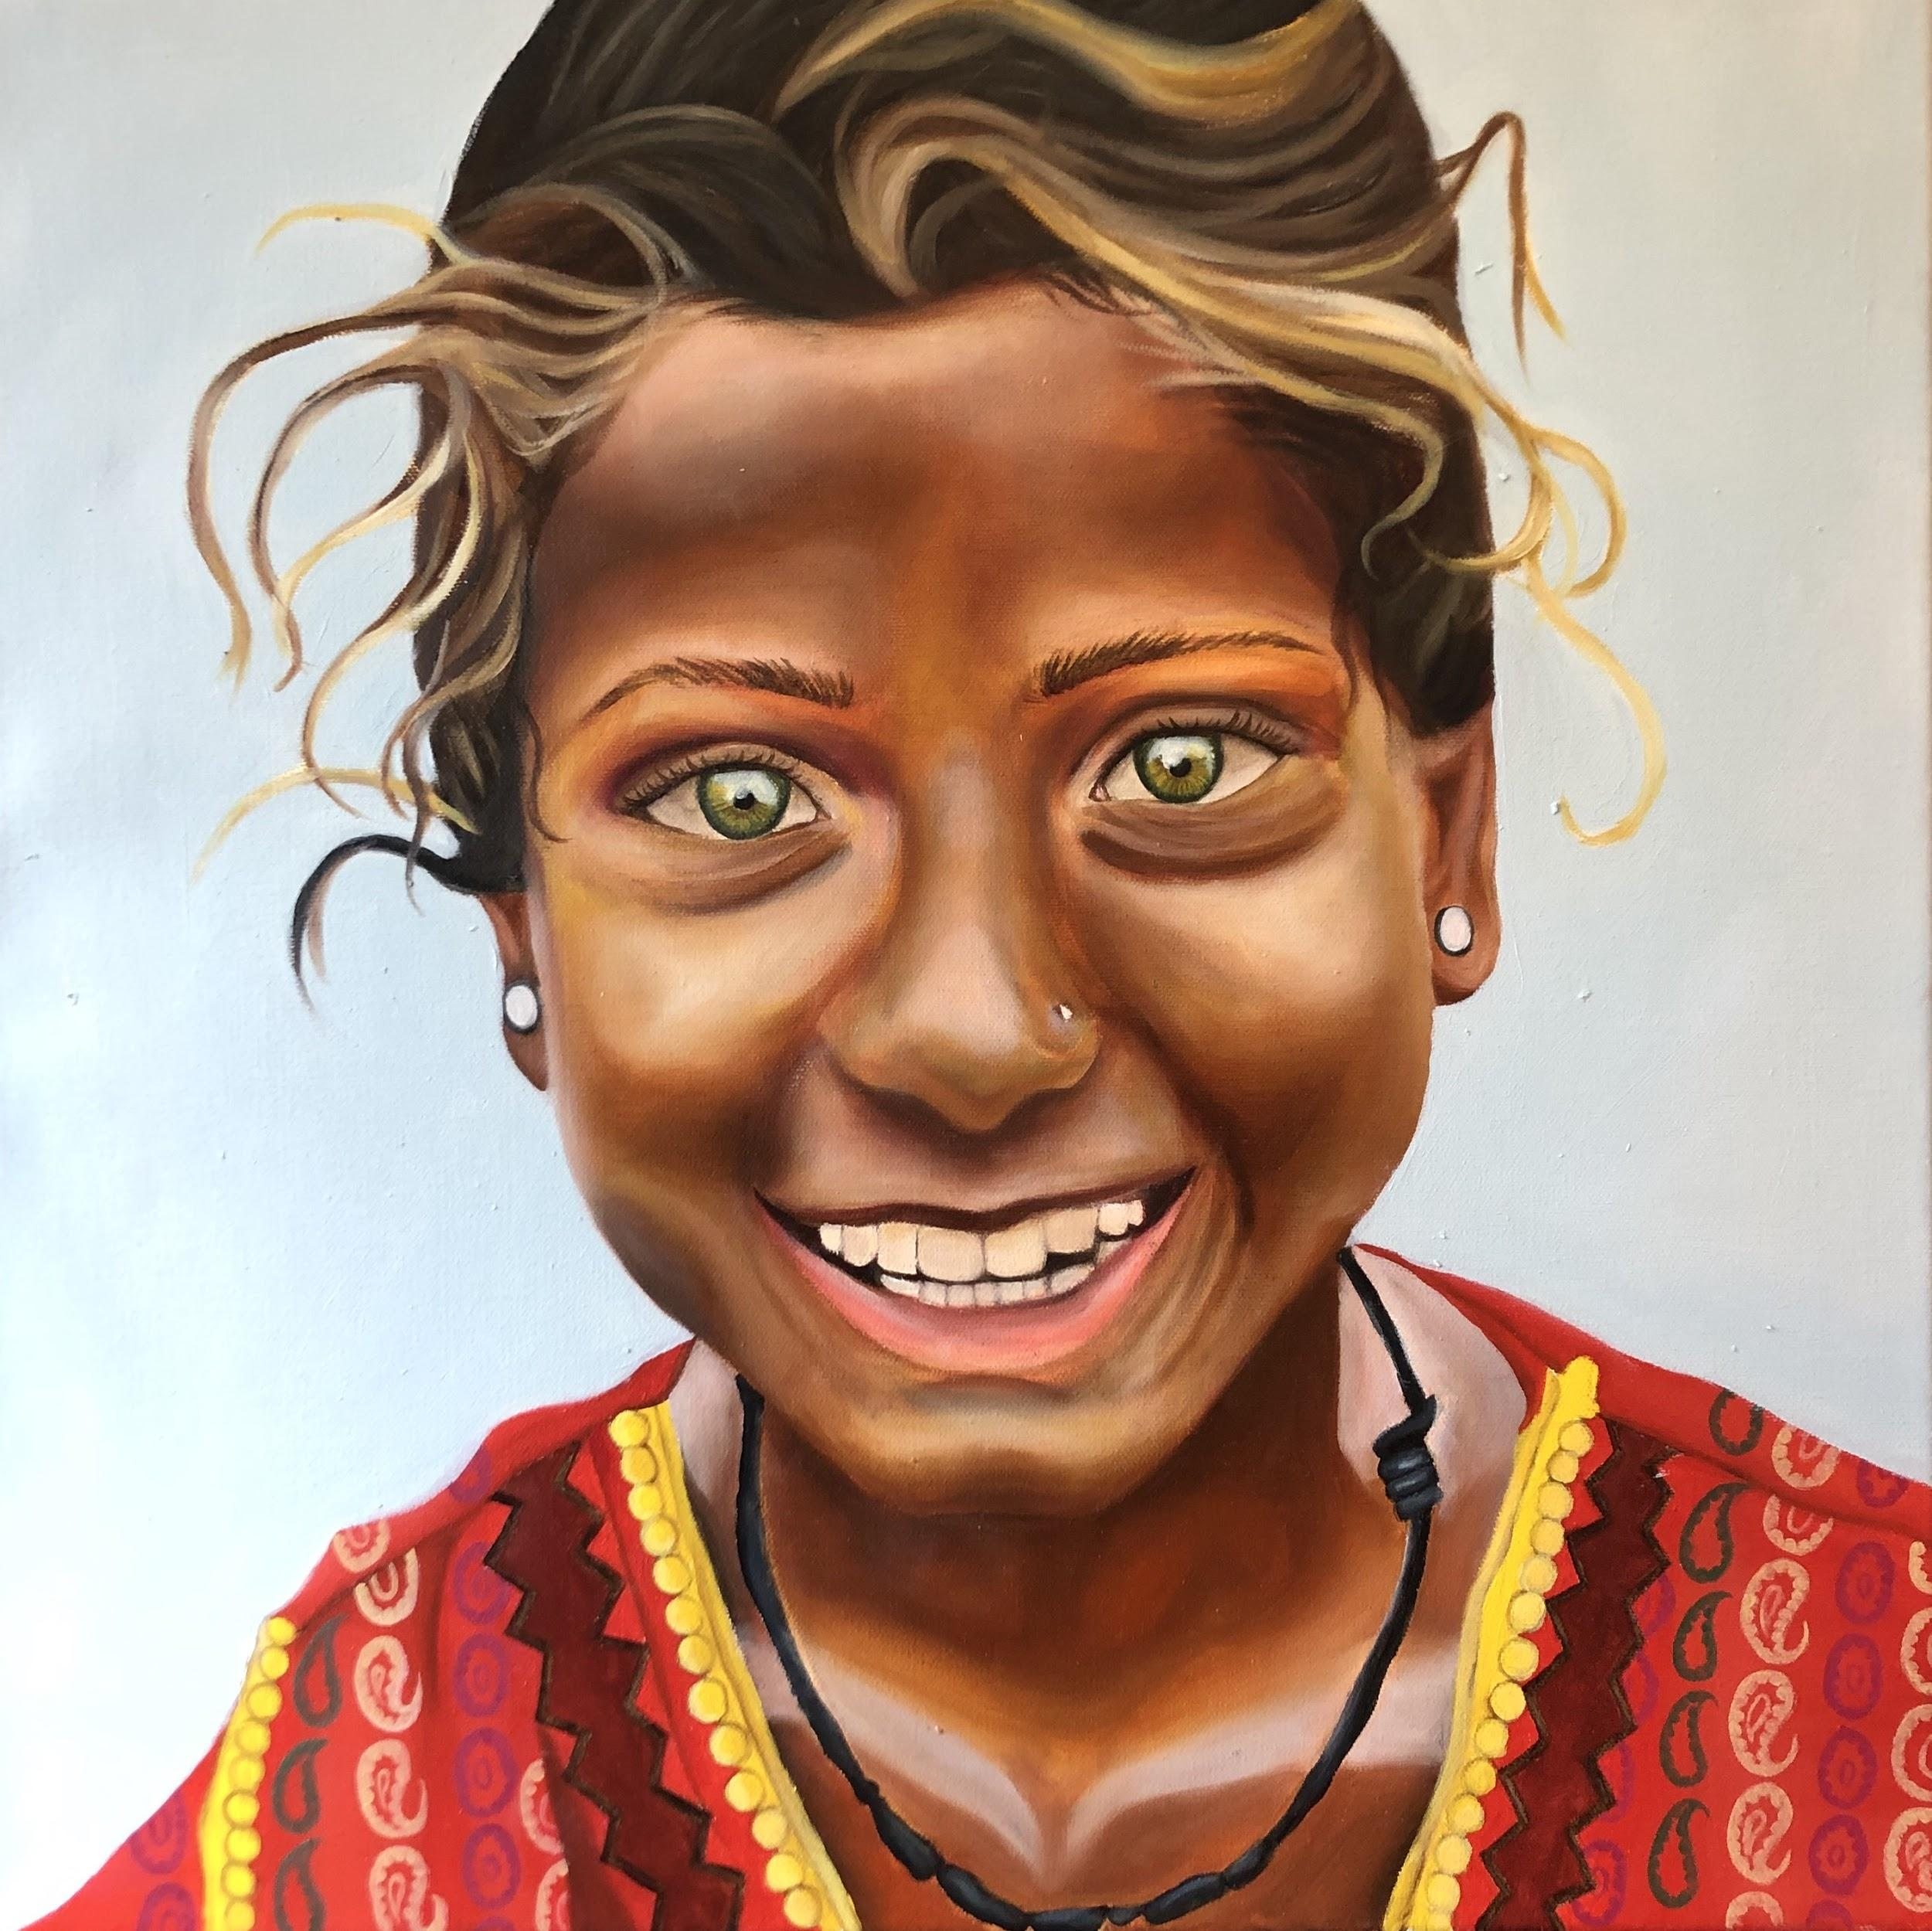
Mumbai, India
Oil on Canvas
20” by 20” NFS
This painting represents pure joy. I wanted this painting to show a snapshot of a completely happy moment.

Slide 14
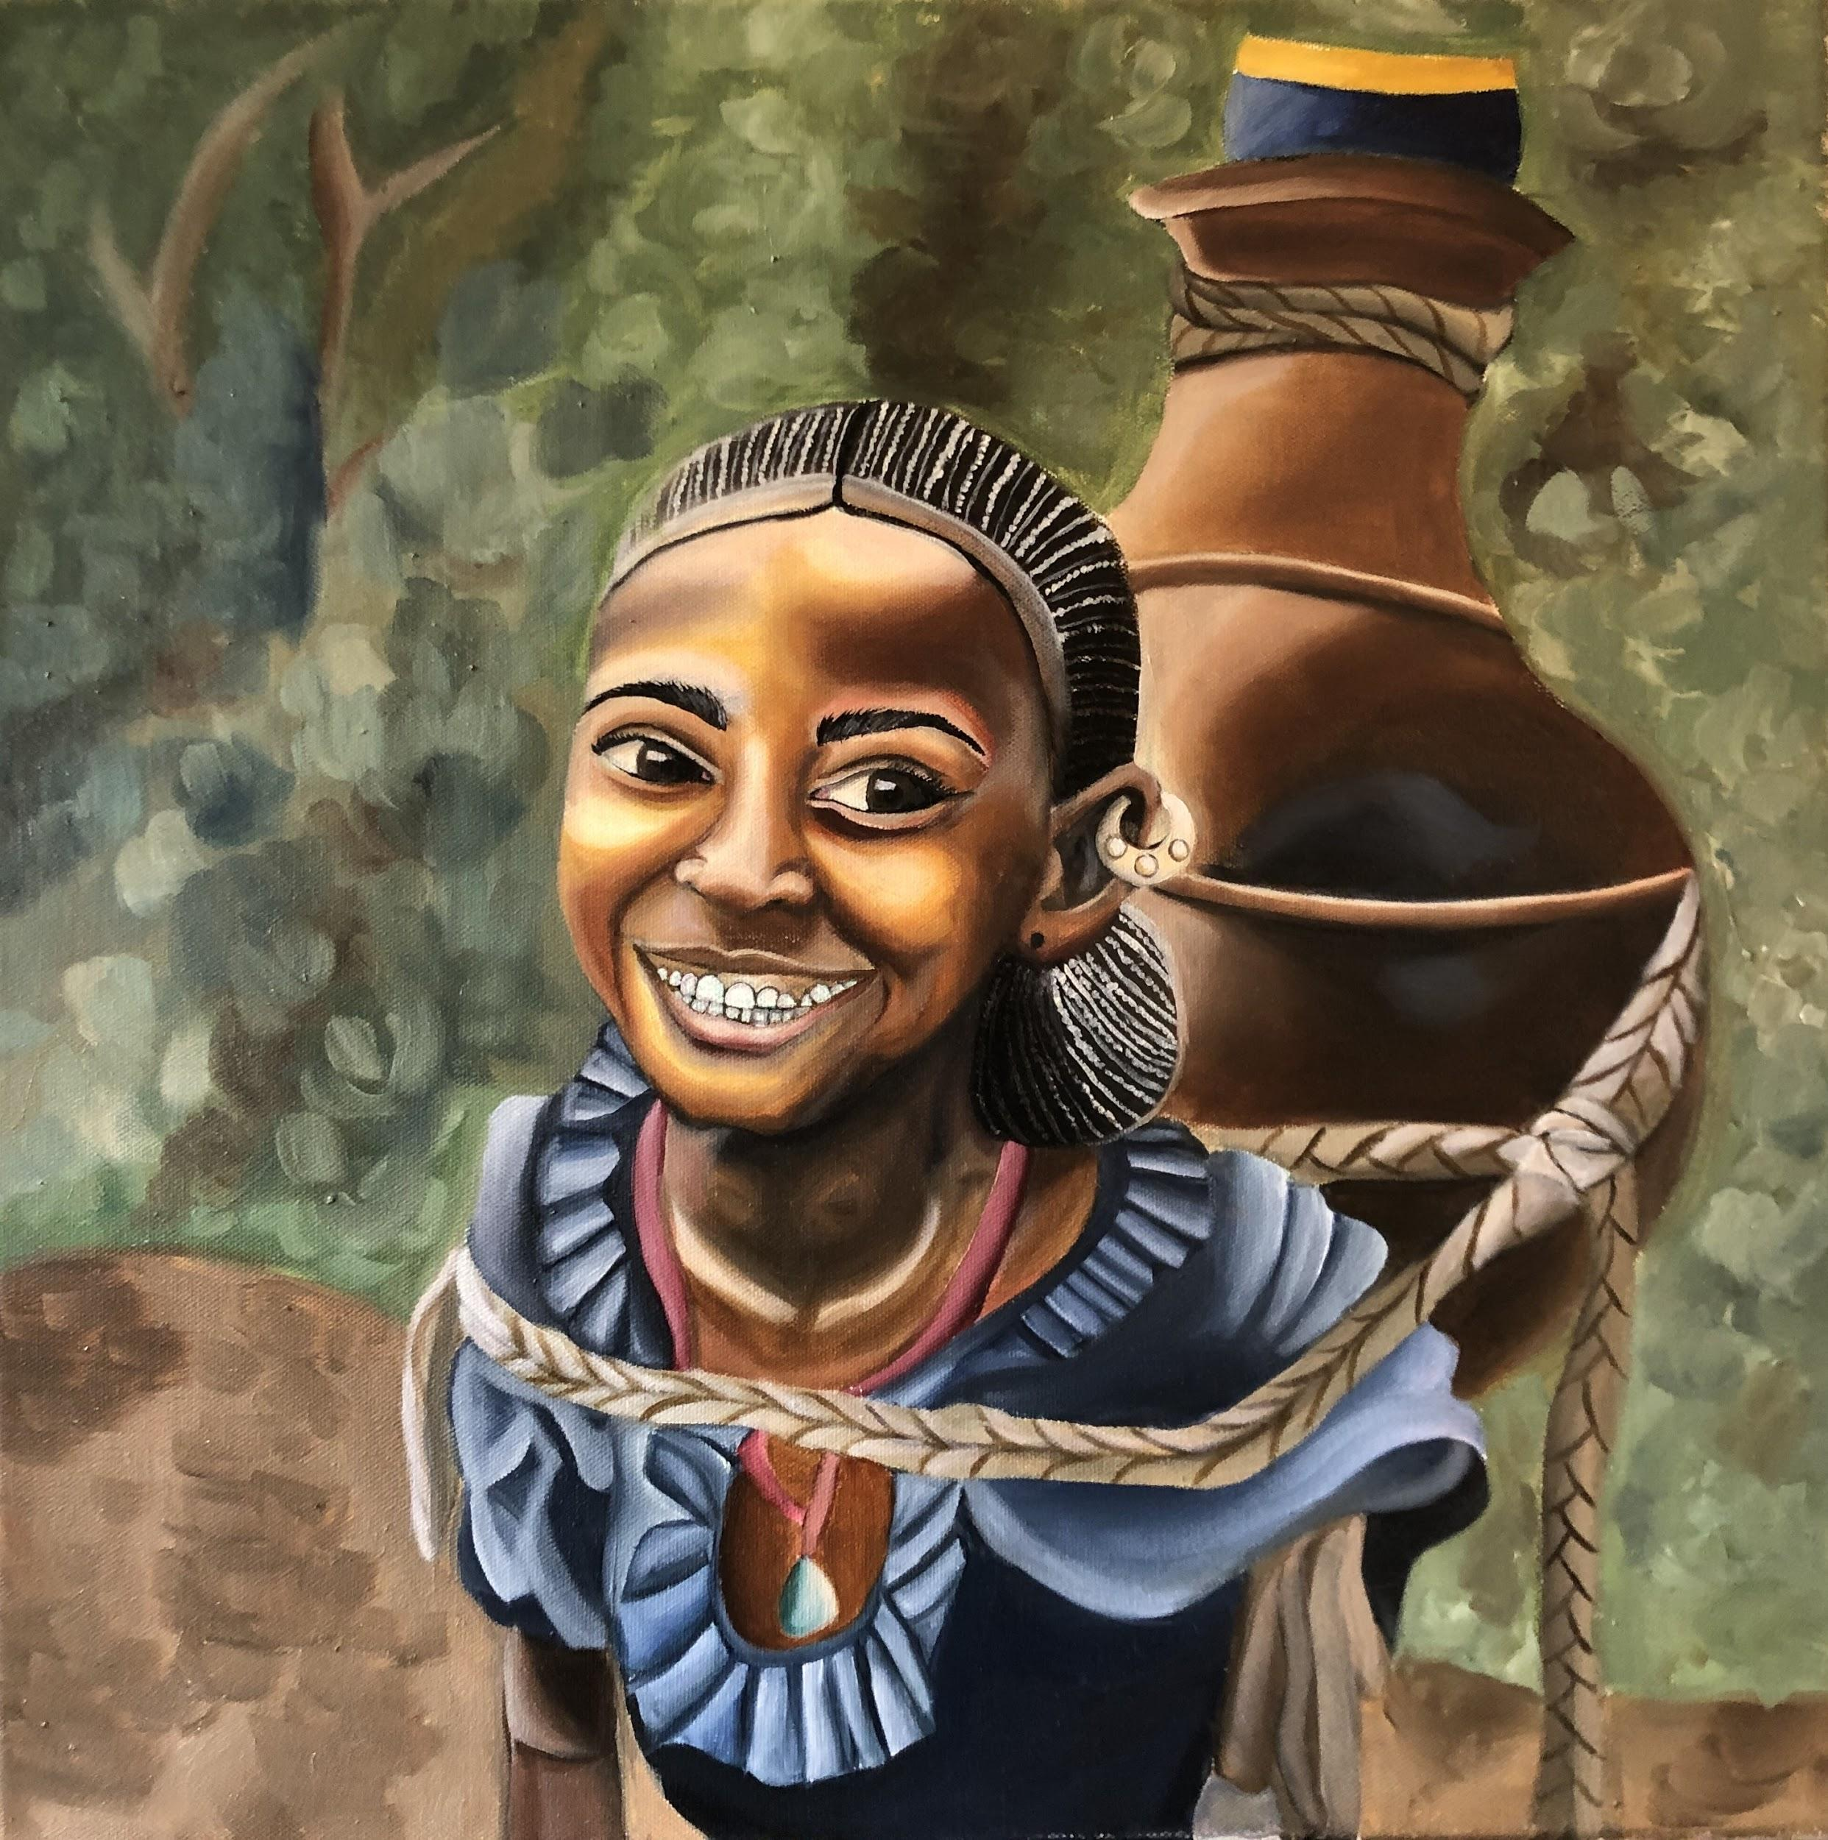
Ethiopia
Oil on Canvas
20” by 20” NFS
This painting shows a young girl with a genuinely positive attitude.

Slide 15
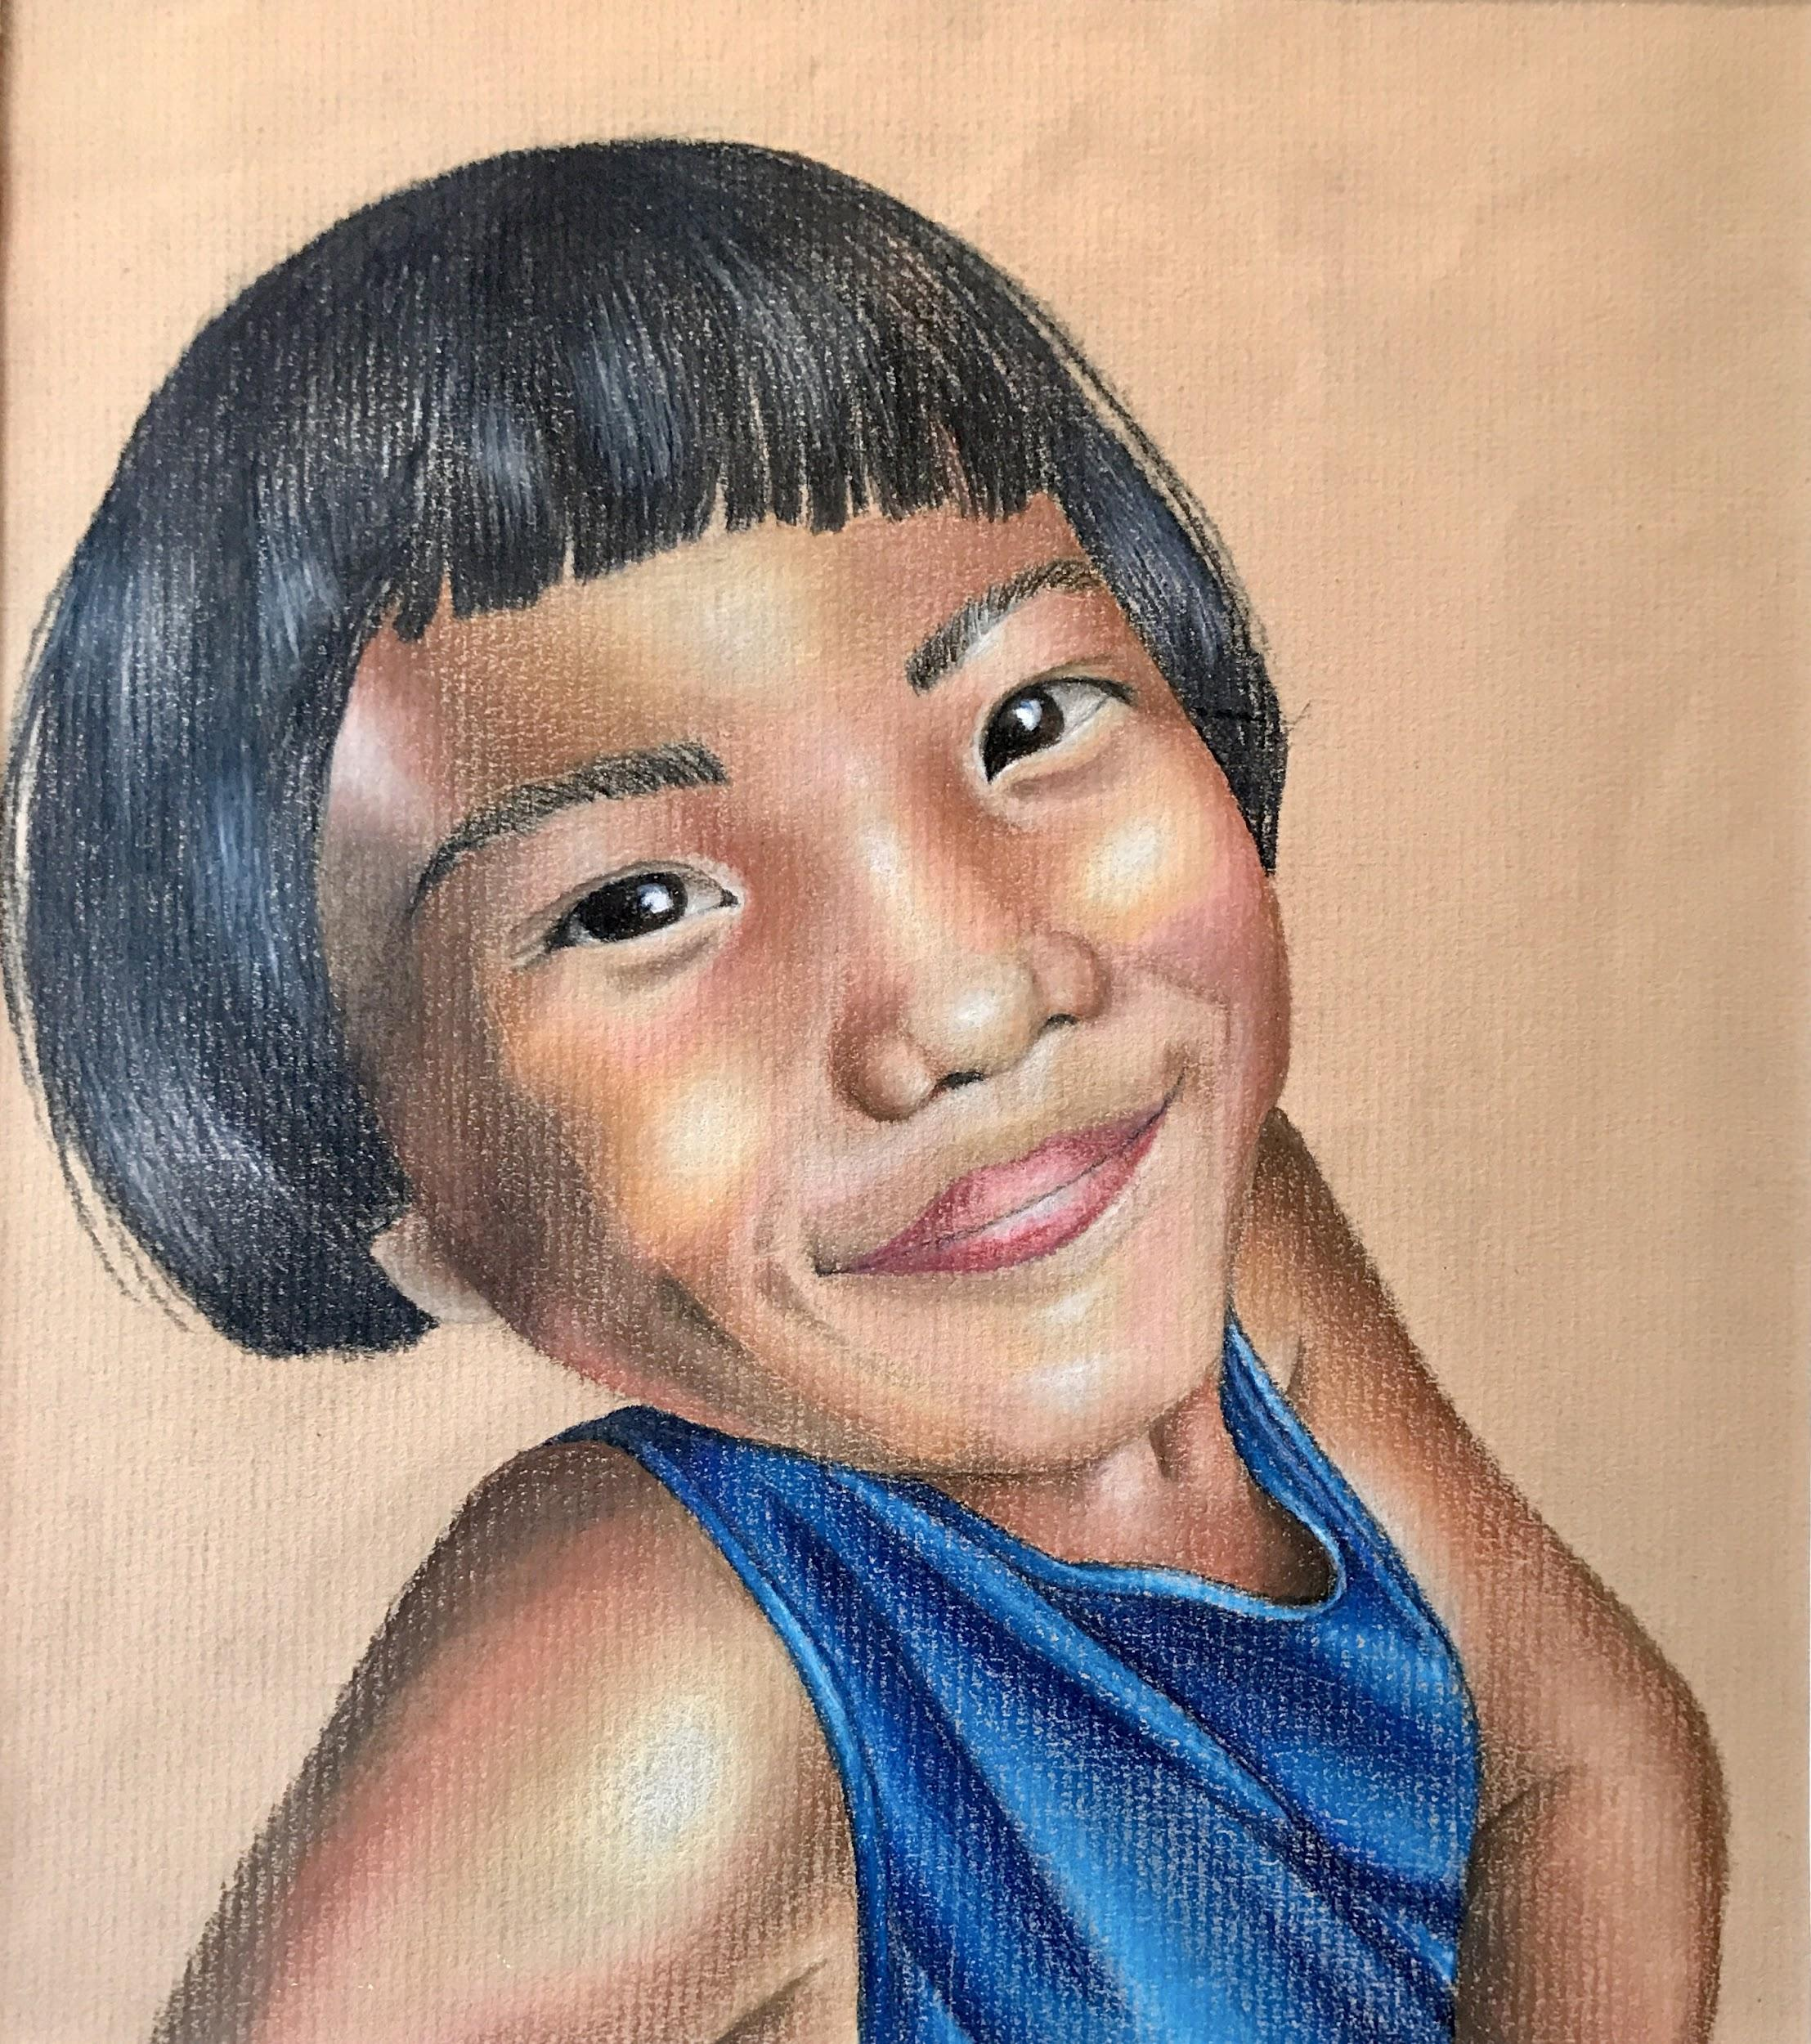
Chiang Mai, Thailand
Prismacolor
8½” by 7½” NFS
This painting shows innocence and joy during hard times. This picture was taken during my cousin’s humanitarian trip to Thailand. She was one of the orphans she was building an orphanage for.

